Slide 1
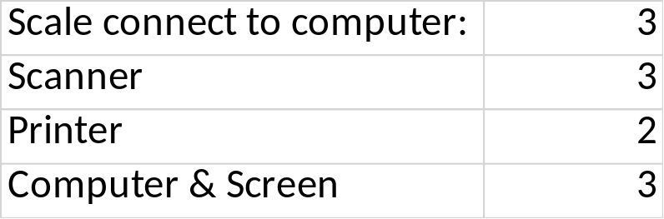
Scan & Scale Station Runner
Scans & Scales incoming Runner weight
No printing
Recycling in Station
Scan & Scale Station Mixing
Copy Label Station
Scan & Scale Mixed Material returning
Scan previous label & Scale granulated materials for runner & usable defects
Print new Label with weight
Later: also for Framapur, Contaminated etc.
Possible to import in Winline
Article information input (as Quyens file)
Scale RM & Recycle
Create Barcode
Possible to import in Winline
Print (need to look in detail how many of each needed):
  Mixing label
  Runner label
  Defect label
  Black Dot label
  Contamination label
Later: Connection to Kanban system, add Color formula information
Can scan and print copies for Runner, Defect etc labels if more needed
(can first do all in “Runner Station”)
Scan & Scale Station Defect, Black Dot, Contaminated
Scans & Scales incoming Defect, BD, Contaminated boxes.
No printing
(can first do all in “Runner Station”)

